Slide 1


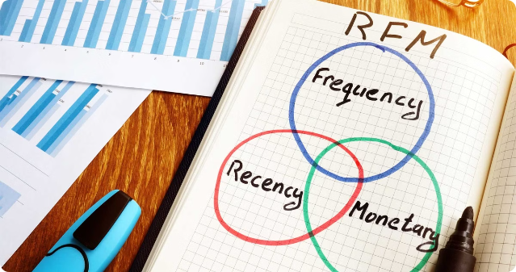
Customer Segmentation using RFM Analysis
BY
Subhadeep Dey
Koustav Mazumder
Mili Chowdhury
Pratishruti Sahoo

Slide 2
Introduction
RFM ( Recency, Frequency, Monetary) analysis is a powerful customer segmentation technique that helps businesses better understand and target their customers. By analyzing a customer's recent purchases, frequency of purchases, and total spend, companies can identify their most valuable customers and tailor marketing strategies accordingly.

Slide 3


Error uploading image.
Use of RFM Analysis for Segmentation
Recency (R): Measures the time since the last customer interaction or purchase.
Monetary Value (M): Represents the total monetary value of a customer's transactions.
1
2
3
Frequency (F): Examines how often a customer interacts with the business.

Slide 4







7-Segment Solution: R, F, M Variables
(using K-Means)
Inactive Customers
1
low Frequency and low Monetary value
2
Dormant Customers
higher Frequency but lower Monetary value
Loyal Customers
3
low Recency, indicating recent purchases, purchase frequently and have a high Monetary value
4
Potential Loyalists
high Recency, low Frequency, High Monetary Value
5
Needs Attention
Moderate Recency, Moderate Frequency, Low Monetary Value
6
Big Spenders
High Monetary value, moderate Recency, low frequency
Recent Customers
7
Low Recency, lower Frequency and moderate Monetary value.
By using K-Means clustering on the RFM variables, we can identify 7 distinct customer segments. This provides a granular view of our customer base, allowing us to tailor our marketing strategies and offers to each group's unique needs and behaviors.

Slide 5
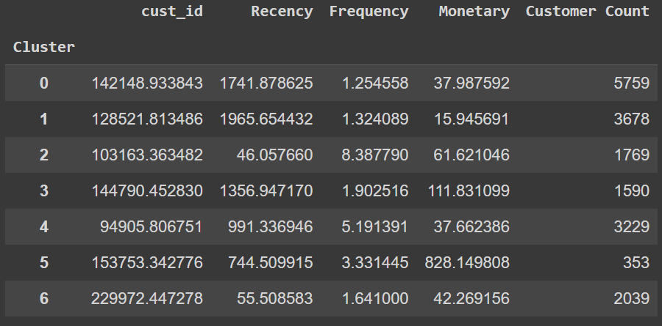
7 Segments

Slide 6
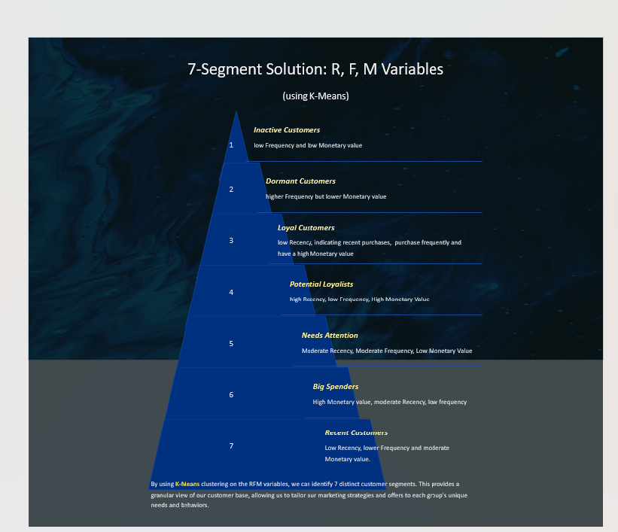

Slide 7
Cluster 2: Loyal Customers - Most Valuable Segment
Identify and Retain Loyal Customers: This market group consists of our most valuable clients, who make regular, high-value purchases. In order to keep these devoted customers, need to concentrate on delivering an outstanding customer experience.
Personalized Offers and Communications: Offering personalized promotions, exclusive access, and tailored communications to show appreciation for business and need to encourage continued loyalty.
Implement Loyalty Programs: Consider developing a robust loyalty program with rewarding incentives to further strengthen the bond between the brand and these highly engaged customers.
Engagement Campaigns: Create engaging content that strengthens the emotional connection with the brand. Share success stories, behind-the-scenes content, or invite them to participate in product feedback sessions.
Monitor and Analyze Behavior: Closely track the purchasing patterns and preferences of this segment to anticipate their needs and proactively address any potential churn risks.

Slide 8
Cluster 5: Big Spenders - Second Most Valuable Segment
High Monetary worth: This group is the most willing to spend financially, as seen by their highest monetary worth. Revenue may significantly increase if this section is maintained and grown.
Potential for Increased Frequency: While they don't purchase frequently, their high spending suggests a potential for increasing purchase frequency with the right strategies.
Exclusive Membership or VIP Programs can increase the frequency of the customers.
Using personalized communication strategies to make customers feel appreciated, sending thank-you notes through messages etc. can help.
Offer them limited-edition items, packaged packages, or premium services that correspond with their spending patterns to position expensive goods and services as opulent experiences.

Slide 9
Assignment 2

Slide 10
RFM Scoring Process
Analyze Recency, Frequency, and Monetary Value of customer transactions to assess their value to the business.
●Recency Score: Scoring: 1 for >1070 days, 2 for 365-1070 days, 3 0-365.
●Frequency Score: Emphasis on customer engagement. Scoring: 0-2 for 1, 2 for 2-4, 3 is more than 4.
●Monetary Score: Significance of spending. Scoring: 1 for <50, 2 for 50-100, 3 otherwise.
RFM Scores Calculation
Recency Score: Determined based on the time since the customer's last transaction, with higher scores for more recent interactions.
Frequency Score: Assigned based on the number of transactions, with higher scores for more frequent customer activity.
Monetary Score: Calculated according to the customer's spending level, assigning higher scores for higher monetary value transactions.
●RFM SCORE Combination: Composite score formula: R*100 + F *10 + M*1.

Slide 11
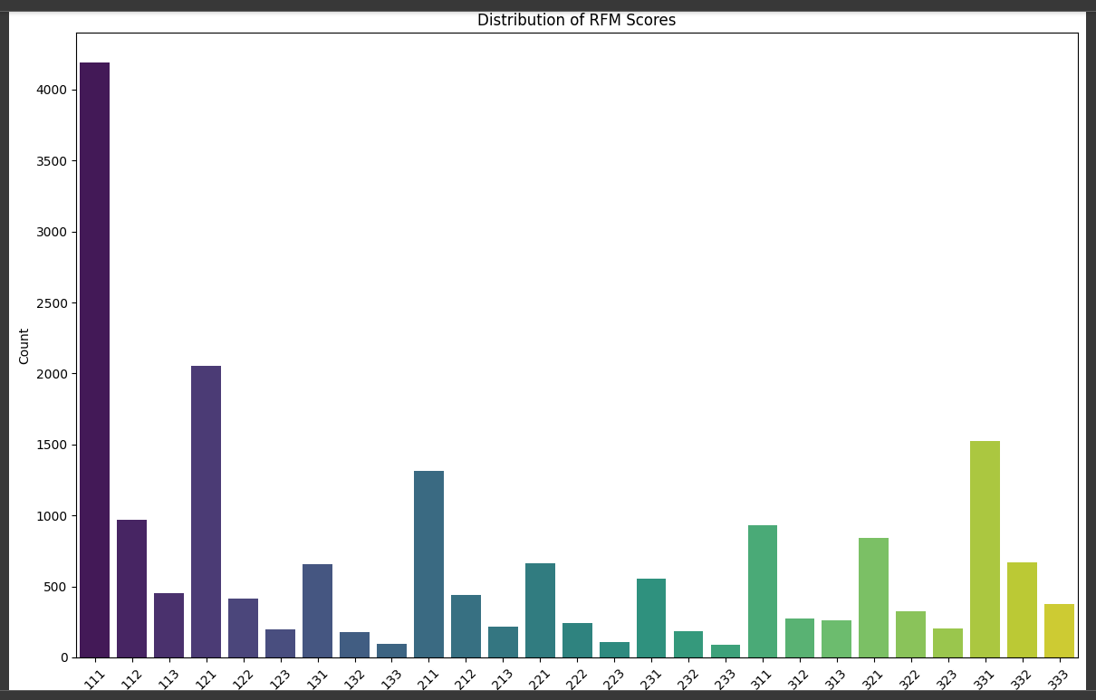
Distribution of RFM Scores

Slide 12
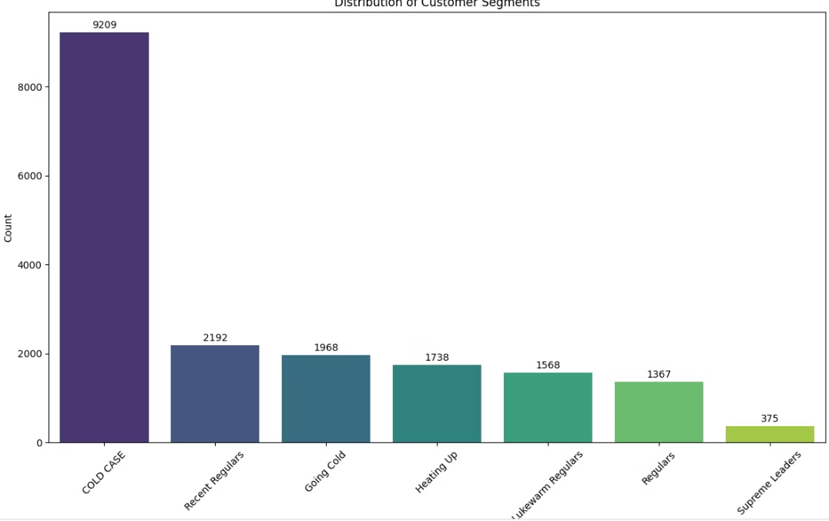
Distribution of Customer Segments

Slide 13
Distribution of Customer Segments
Cold Case: High Recency, low purchase frequency, and contribute minimally to the revenue.
Recent Regulars: Low Recency, frequency and spending may vary but are relatively moderate.
Going Cold: Recency is getting higher, suggesting they haven't bought recently, and their frequency might be dropping. They are at risk of becoming inactive.
Heating Up: Customers in this segment are showing increasing engagement.
Lukewarm Regulars: Decent frequency, most loyal segments, moderate spending.
Regulars: This segment consists of customers who buy consistently but not at the highest frequency or spending levels. They are stable and reliable contributors to revenue.
Supreme Leaders: This is the smallest yet most valuable segment, having highest monetary value.

Slide 14
Key Segments for Business Uplift

Slide 15
Cluster 2: Recent Regulars - Most Valuable Segment
These customers have shown recent engagement and have high potential to become loyal, high-value buyers.
Targeting them is cost-effective and can significantly boost retention.
Strategies
Strategies to re-engage them include personalized marketing campaigns with tailored recommendations, exclusive loyalty rewards, and enhanced customer experiences.
Offering dynamic content, cross-selling opportunities, and reactivation campaigns with special offers can further drive repeat purchases.
Additionally, leveraging social proof and building community engagement fosters brand loyalty, turning recent buyers into advocates and maximizing their lifetime value.
This segment’s growth directly impacts revenue and long-term business success.

Slide 16
Cluster 3: Going Cold - Most Valuable Segment
These customers show declining engagement and are at risk of becoming inactive.
By targeting them, businesses can prevent churn and potentially reignite their purchasing habits.
Strategies
Strategies to re-engage them include sending personalized reactivation emails with exclusive offers and discounts, analyzing past behavior to offer tailored product recommendations, and providing incentives like loyalty rewards or special deals.
Additionally, addressing potential pain points through feedback and enhancing their shopping experience can encourage them to return.
Proactive communication and engagement are essential to transforming this segment back into active, loyal customers.

Slide 17

Thank You
We appreciate your time and attention throughout this presentation. The insights gained from the RFM analysis have provided a valuable framework for understanding and segmenting your customer base. Moving forward, we are excited to work with you to implement targeted strategies that will drive business growth and maximize customer lifetime value.

